Slide 1
SWE 690 -CAPSTONE PROJECT AT YOUR SERVICE
Under the guidance of Professor Richard Riehle
By,
Kavya Suresh Babu.
Student id : 90290

Slide 2
HELP!
As a Transitive verb
to give assistance or support to <help a child with homework>
archaic : rescue, save
to change for the better
As an Intransitive verb
to give assistance or support —often used with out <helps out with the housework>
to be of use or benefit <every little bit helps>

Slide 3
About the project!
In this chaotic world where competition is everything, we forget the basic necessities for survival.
For example, we forget to eat and once we remember, we realize we don’t have the necessary ingredients to make a decent meal.
We are so busy with our lives ,our projects and assignments trying to climb up the corporate ladder, that we don’t have time for small things like a child’s homework.
Or, even worry about hygiene, clean up the house and keep our environment clean.
Let’s admit it! WE NEED HELP!
This app is just a click away from providing you all the services you need to make you a SUPER HUMAN!! We bring all these services to your doorstep so there is no need for you to get out of your house to get the work done.

Slide 4
AT YOUR SERVICE!! – HELP IS JUST A CLICK AWAY.
Shop for groceries – Give us a list of your groceries and from which store you want them, and we’ll do the shopping for you.
Home Services – Your house needs cleaning ? Dirty laundry? Blocked Drain? Or any sort of Repairs and Maintenance? Hire one of our help to fix all your problems.
Child Needs Services - Do your child need a tutor ? A baby- sitter for a few hours?

Slide 5
Platform, Languages, Database and Tools
Web Application.
Java Servlets, HTML and CSS.
MySQL database.
Eclipse, MySQL workbench 6.3 CE and Android Studio.

Slide 6
What are the features implemented in this project ?
Home Page – to list all available categories
Groceries – list of groceries categorized according to the type.
Repair and Maintenance – list of all available services.
Child Care – list of Tutors and Baby-sitters.
Admin module – to register the service care providers.

Slide 7
Users
Users can browser the website without having to register or login to the website.
Under the categories – Repair and Maintenance, and Child Care, users can view the list of registered service providers and can also request for further details to be published.
For groceries – users can add items to cart multiple times, and view the cart summary to add more products or remove items. In order to confirm the order, user is requested to Register to the website (if he/she is a new user) or login to the website, he/she is an existing customer.

Slide 8

Encrypting the password before storing in the database
Hashing passwords will protect it from attacks. This way people who have access to the database won't know the user's password.
Sometimes, we see that people have the habit of using the same password over and over again. So, if the database is compromised, encryption makes sure that sensitive data is not compromised.
I have used the MD5 hashing algorithm, provided by java.security.MessageDigest, to encrypt my password field for user details.

Slide 9
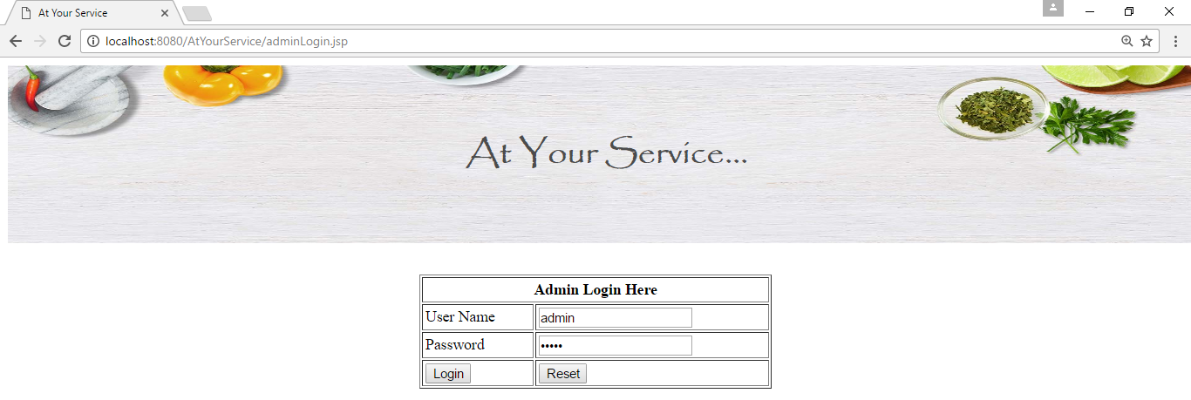
Admin module

Slide 10
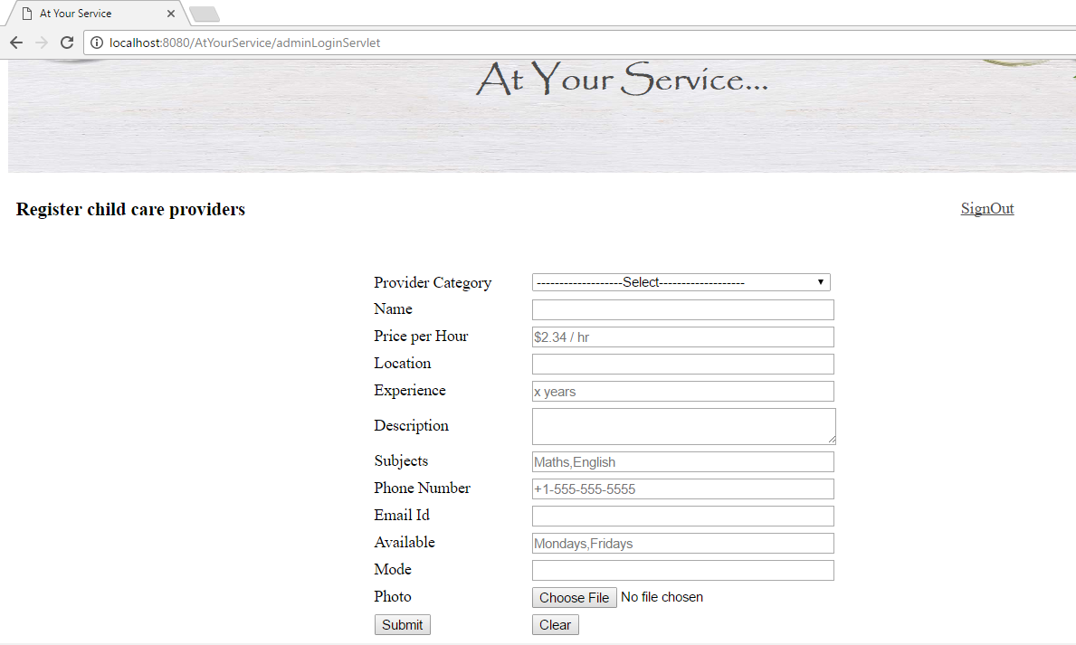
Register a service provider

Slide 11
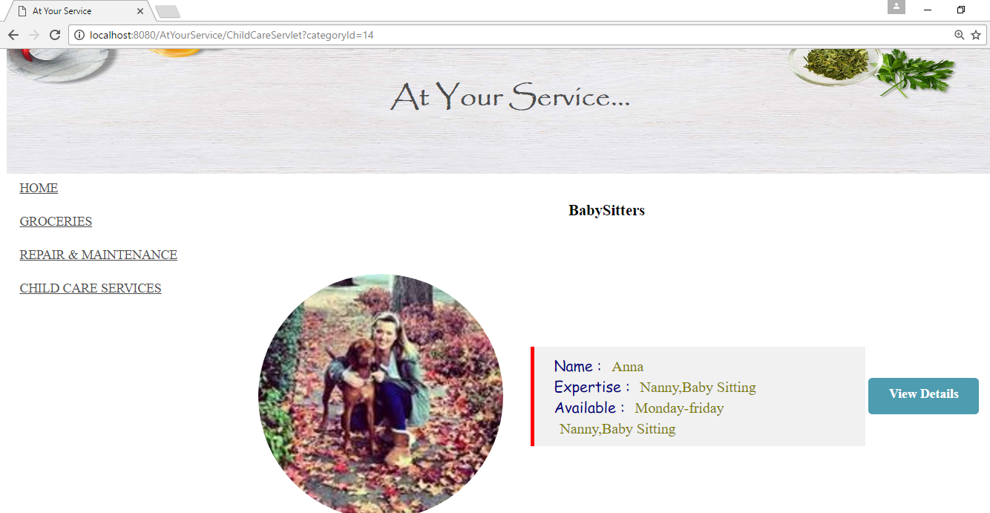
Registered service provider

Slide 12
DEMO

Slide 13
THANK YOU

